Slide 1

AI-Based Cuffless Blood Pressure Estimation Using Vision Transformer
Isha Pal
Purva Wakde
Diksha Choudhary
TEAM MEMBERS :
Dr. Shyama Prasad Mukherjee International Institute of Information Technology, Naya Raipur
IIIT-NR

Slide 2
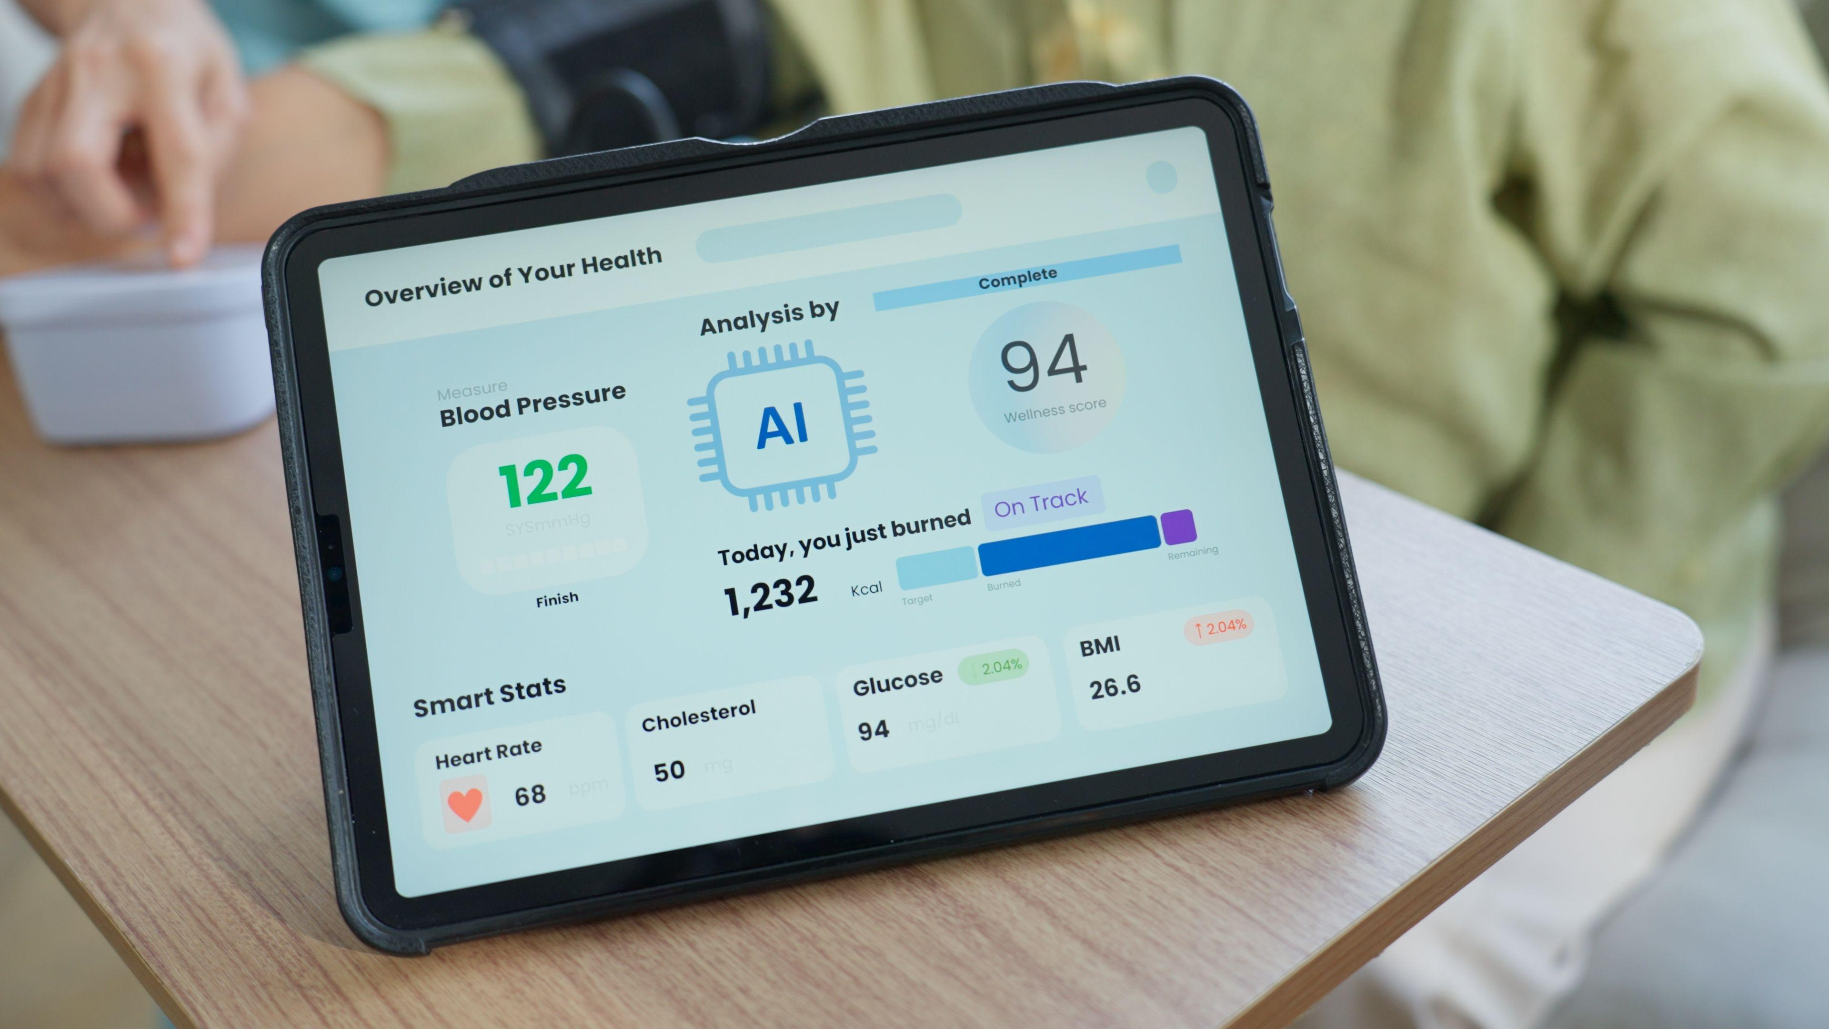
          INTRODUCTION
Blood pressure is one of the most important indicators of cardiovascular health, yet traditional cuff-based devices are uncomfortable and unsuitable for continuous monitoring. This project introduces an AI-powered cuffless blood pressure estimation system that predicts Systolic Blood Pressure (SBP) and Diastolic Blood Pressure (DBP) using only Photoplethysmography (PPG) signals. By converting PPG signals into scalogram images and analysing them with a Vision Transformer (ViT), the system enables accurate, non-invasive, and continuous blood pressure monitoring, making healthcare more comfortable and accessible.

Slide 3
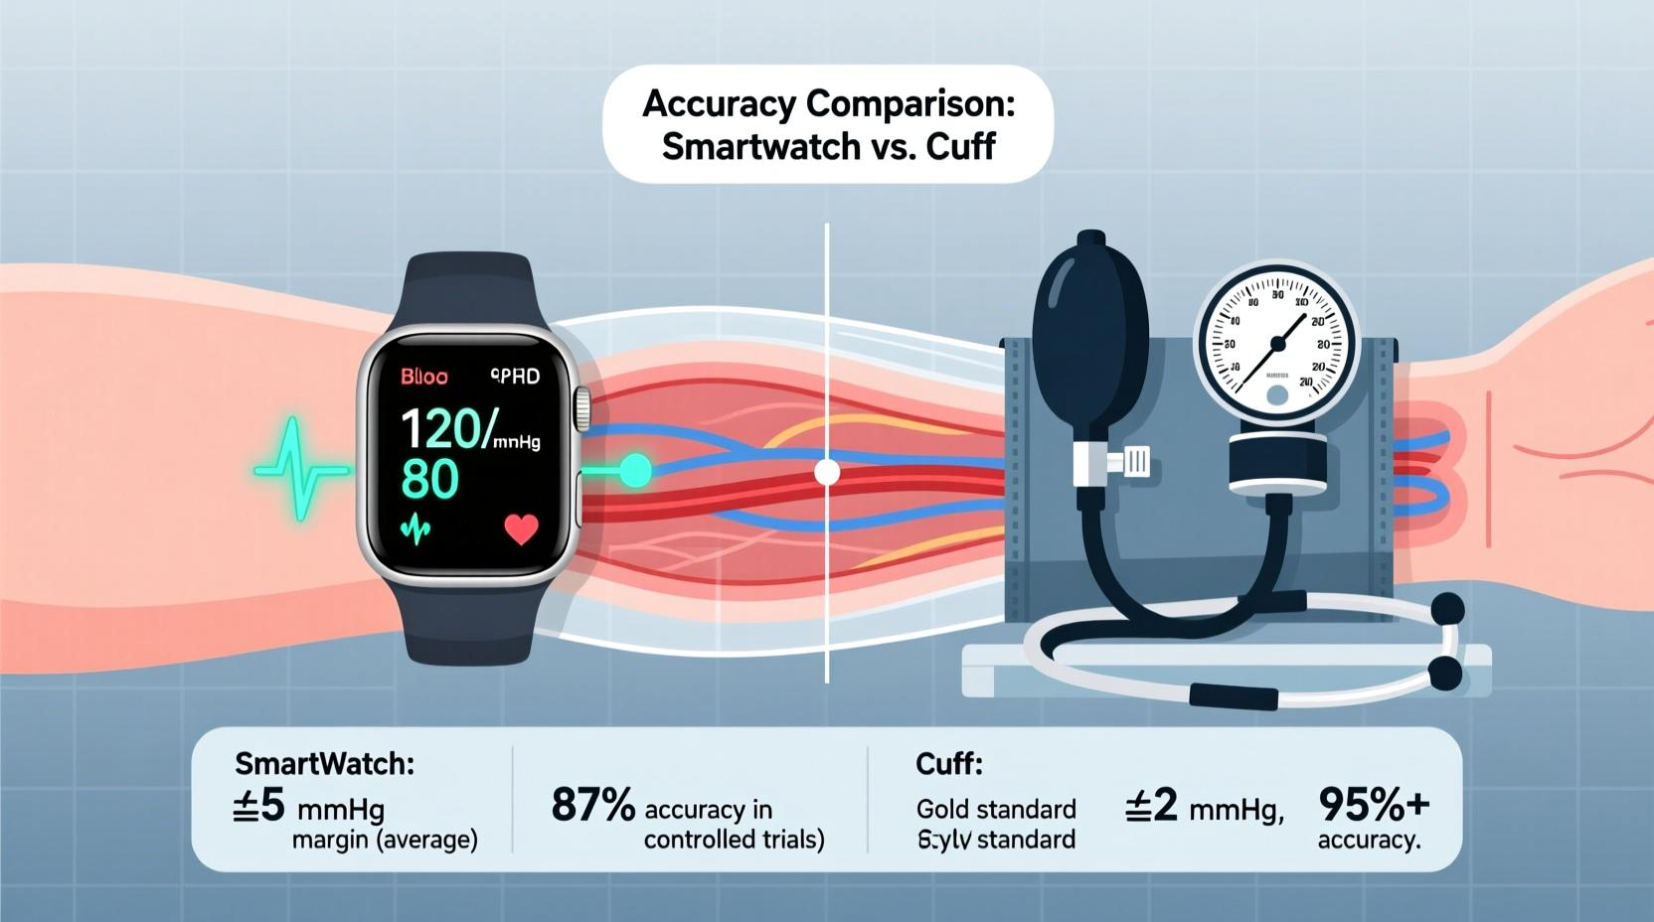
The Problem: Why Cuffless BP Monitoring
Traditional Cuff Devices
Uncomfortable, discontinuous — cannot monitor BP continuously or in real time.
Clinical Need
Continuous, non-invasive, comfortable BP monitoring is essential for ICU patients and home healthcare.
Our solutions:
AI-based cuffless estimation using only PPG signals from lightweight wearable sensors.

Slide 4
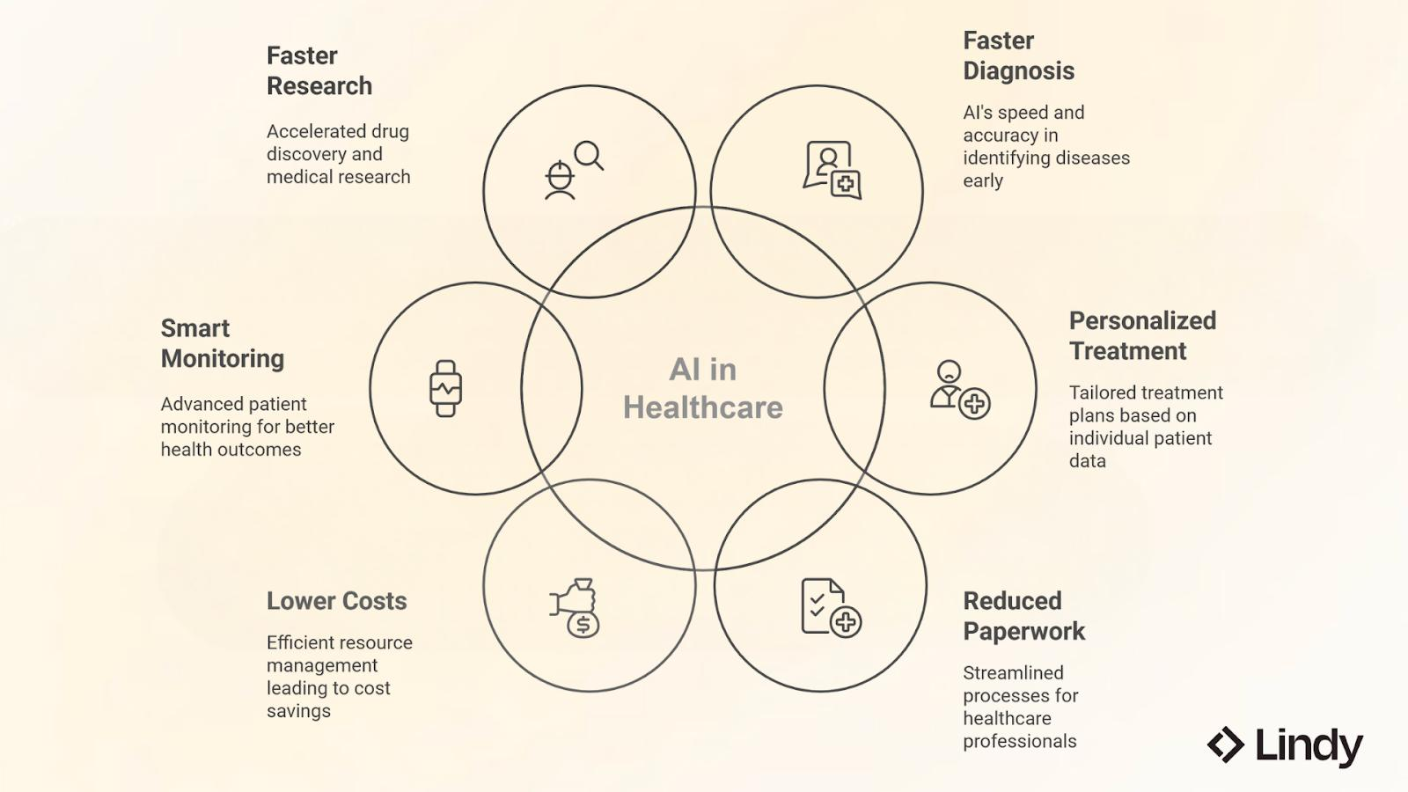
Project Objectives
Primary Objective
It Estimate Systolic (SBP) and Diastolic (DBP) blood pressure values using PPG signals alone — no cuff, no arterial line
Secondary objective
Train a Vision Transformer (ViT) model for BP regression
Generate time-frequency scalograms via Continuous Wavelet Transform
Build an end-to-end prediction pipeline
Evaluate using MAE, RMSE, and R² metrics

Slide 5
Dataset & Data Preparation
The project uses the MIMIC-IV Waveform Database, which contains synchronized PPG and arterial blood pressure signals collected from ICU patients. During preprocessing, invalid records, missing values, and duplicate windows are removed. The signals are normalized, segmented into fixed-length windows, and enhanced by engineering additional cardiovascular features, ensuring high-quality input data for model training.
Step 1
Step 2
Extract valid PPG & ABP records
Segment into fixed-length windows
Step 3
Clean, normalize & feature engineer

Slide 6
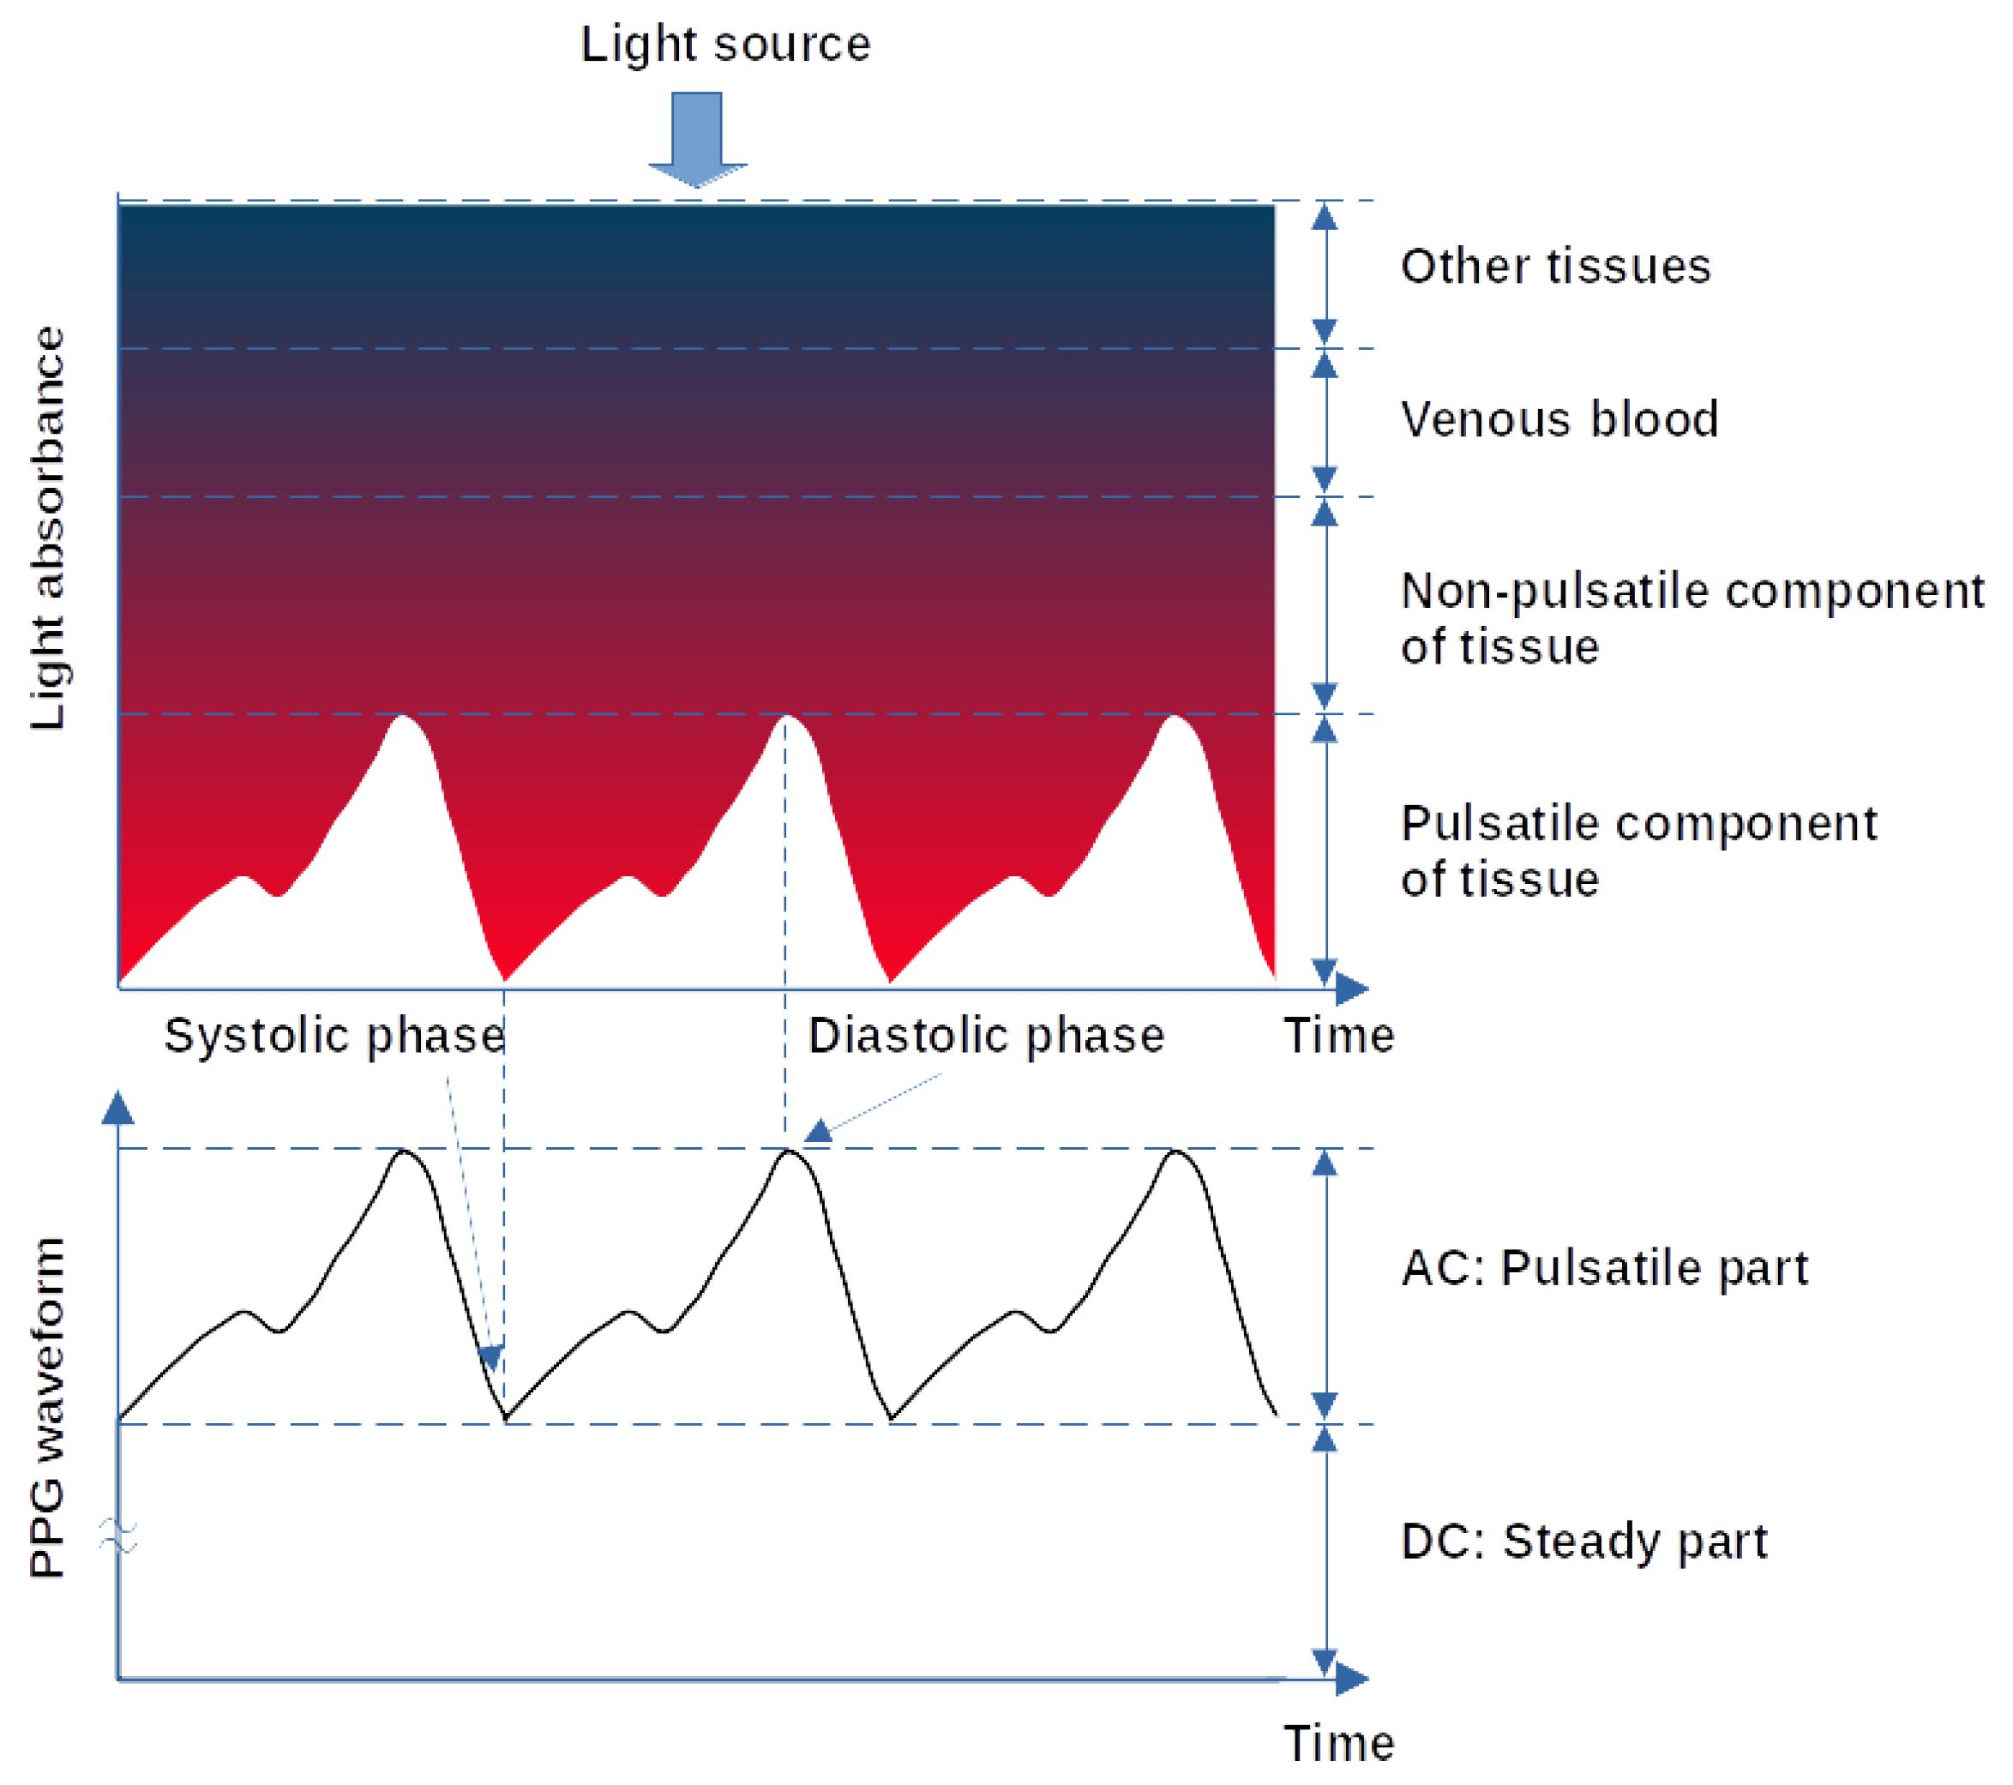
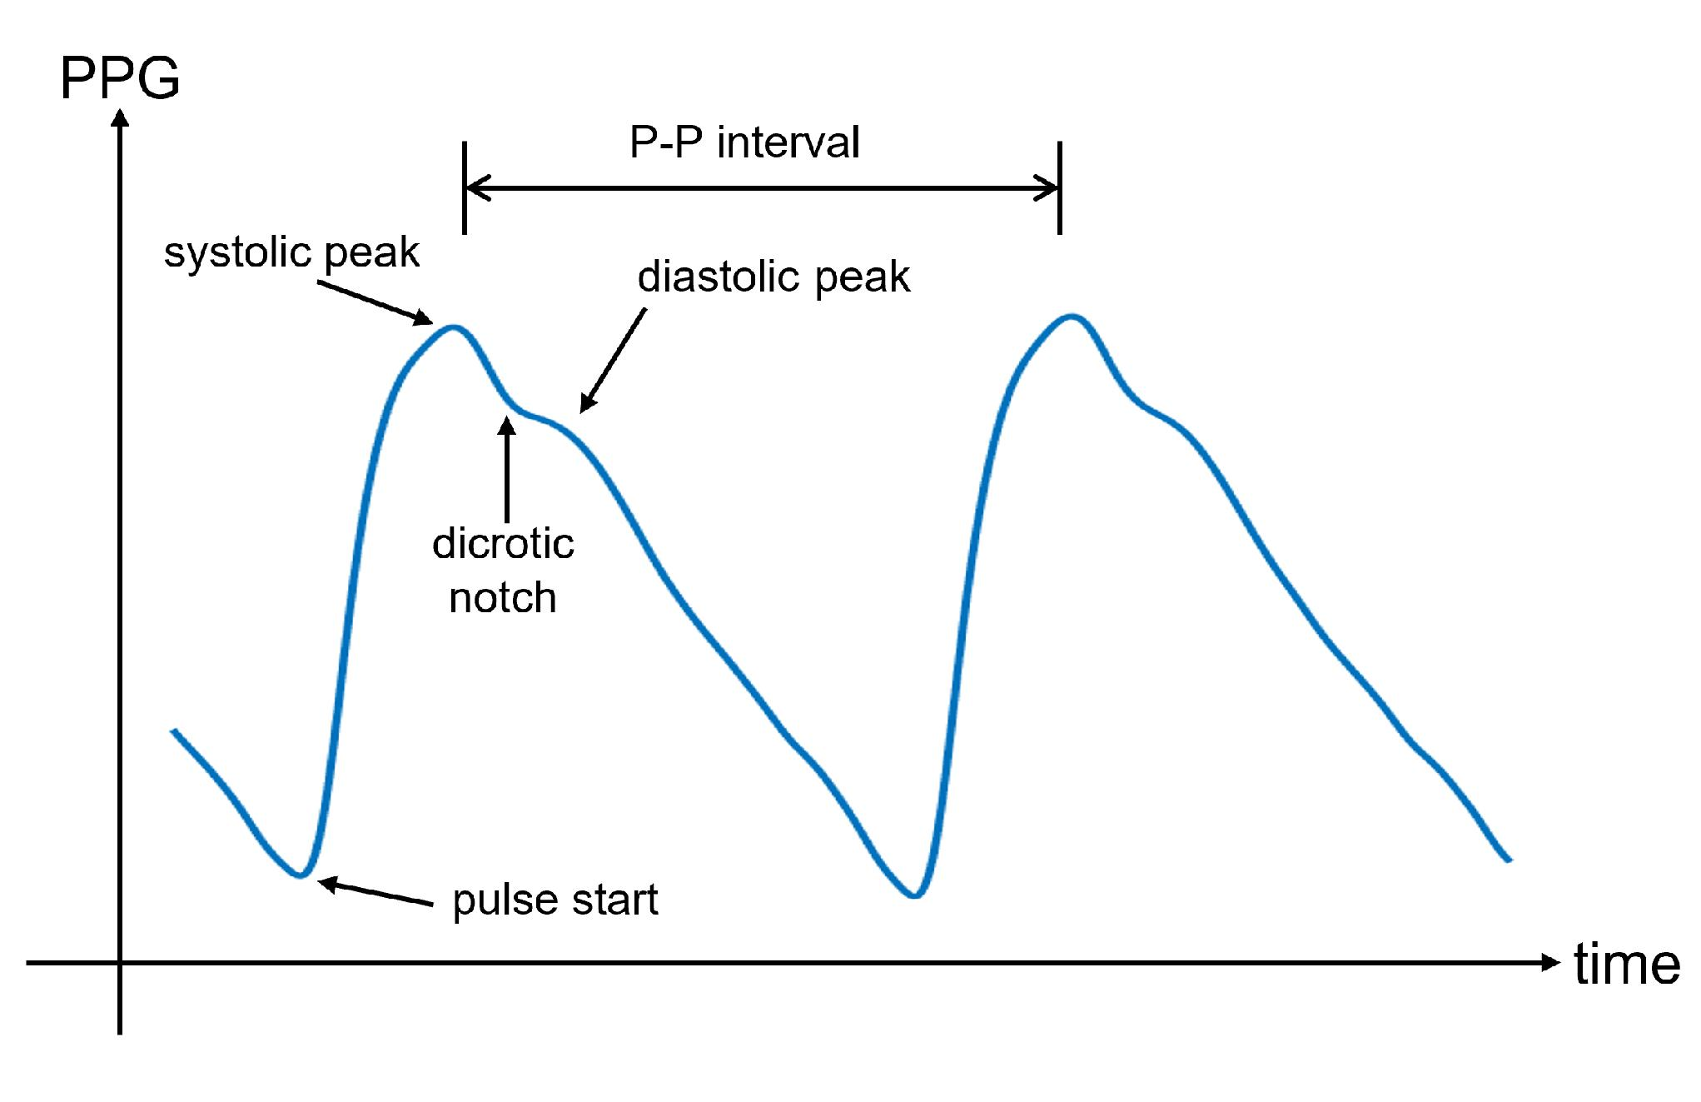
PPG SIGNALS:
Finger blood volume changes
PPG waveform used for BP estimation

Slide 7
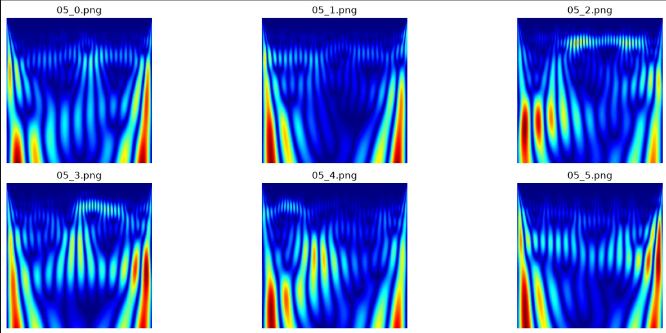
Signal Processing: PPG to Scalogram
Raw PPG signals are transformed into scalogram images using the Continuous Wavelet Transform (CWT). Unlike the original waveform, scalograms represent both time and frequency information simultaneously, allowing the Vision Transformer to learn complex cardiovascular patterns that improve blood pressure estimation accuracy

Slide 8
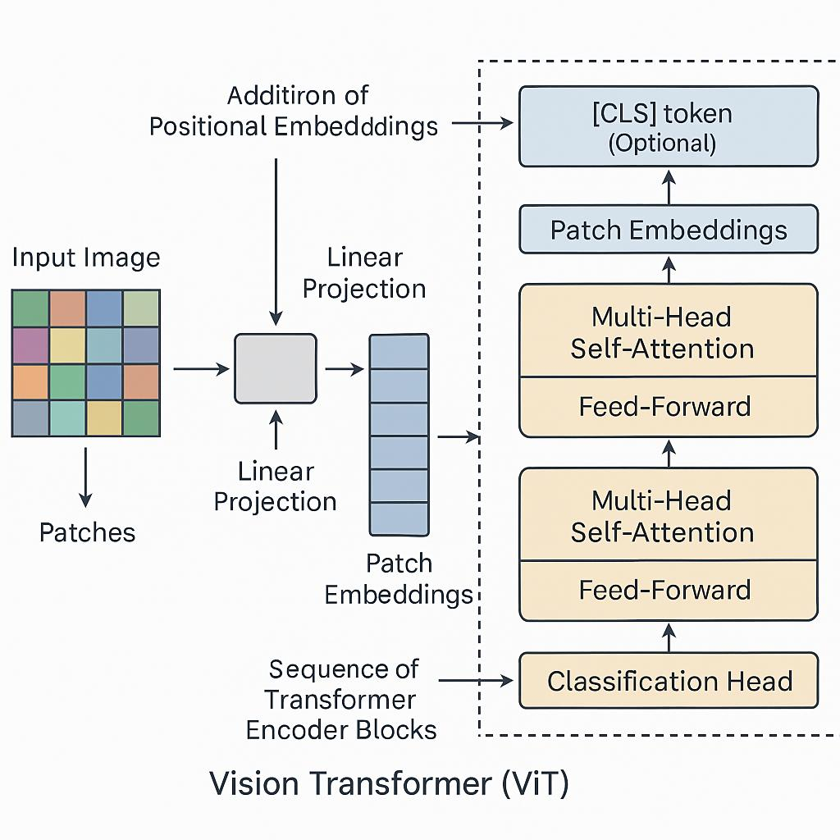
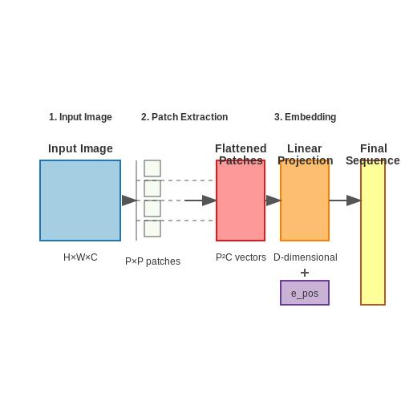
VISION TRANSFORMERS ARCHITECTURE:
Image split into patches
Transformer Encoder
Regression Head
SBP & DBP Prediction

Slide 9

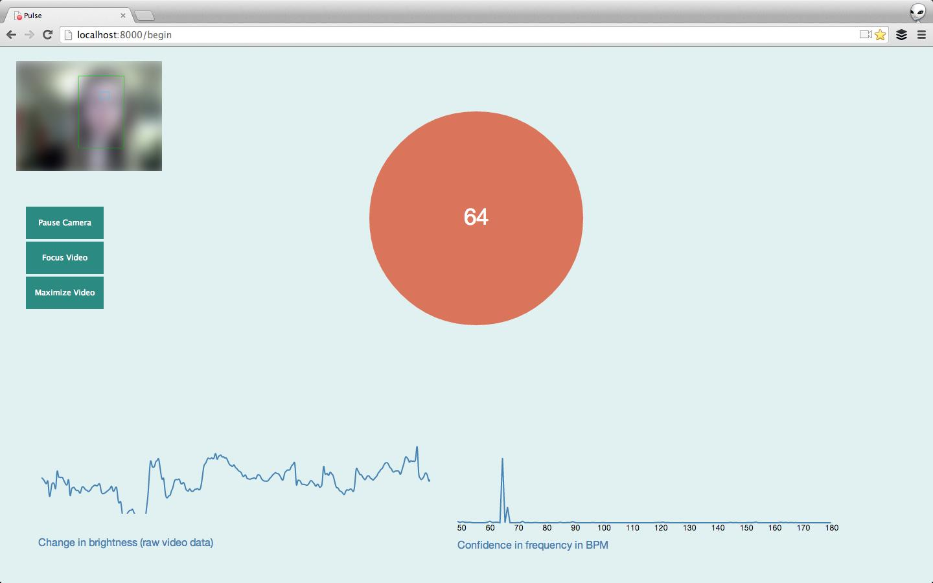
Live Webcam-Based Finger Detection
Real-Time Finger-Based PPG Signal Acquisition
Workflow:
User Places Finger on Webcam
↓
Live Video Capture
↓
Finger Detection & ROI Extraction
↓
PPG Signal Extraction
↓
Signal Preprocessing
↓
Scalogram Generation (CWT)
↓
Vision Transformer Model
↓
SBP & DBP Prediction

Slide 10
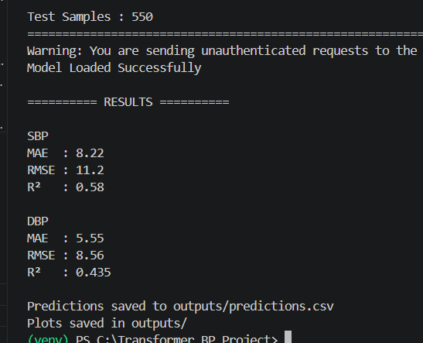
Results & Performance
The proposed model achieved clinically acceptable prediction accuracy with low Mean Absolute Error and Root Mean Squared Error, while maintaining a high R² Score. Scatter plots comparing actual and predicted blood pressure values demonstrate strong agreement, indicating that the Vision Transformer successfully captures meaningful cardiovascular information from PPG-derived scalograms.

Slide 11
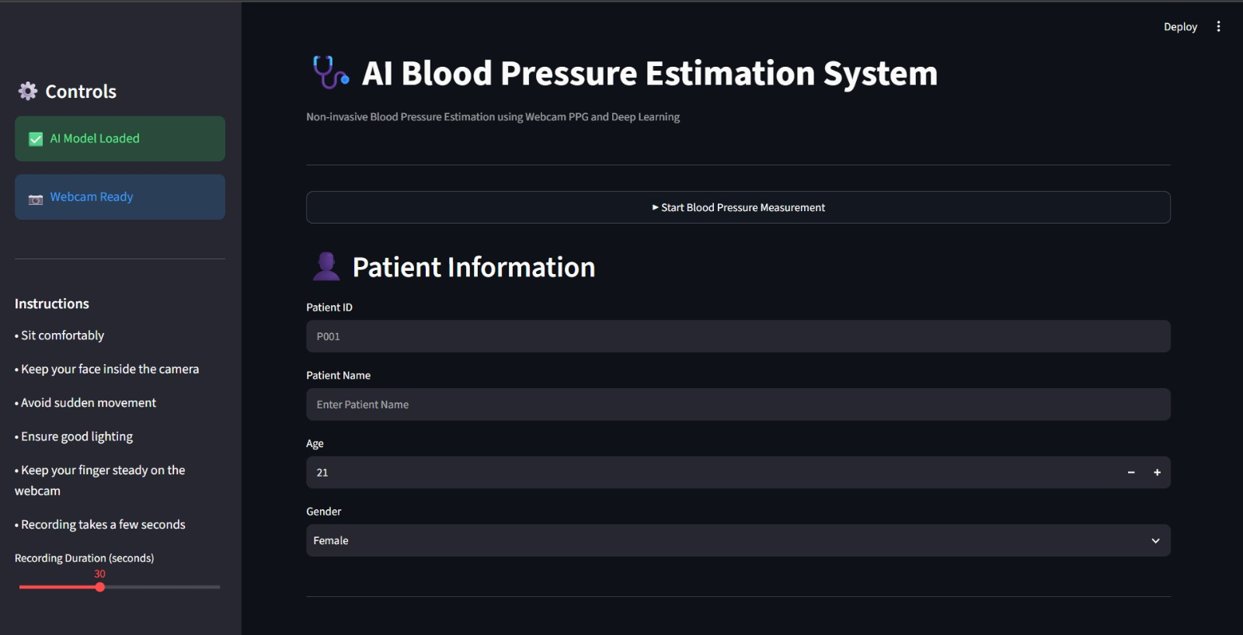
DASHBOARD:

Slide 12
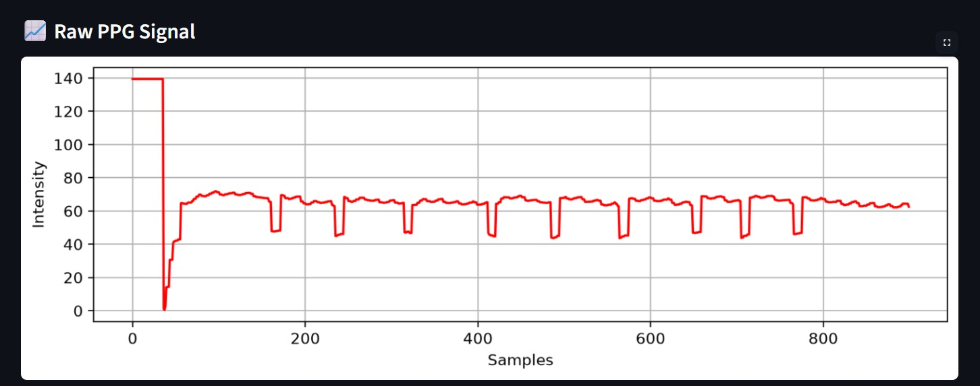
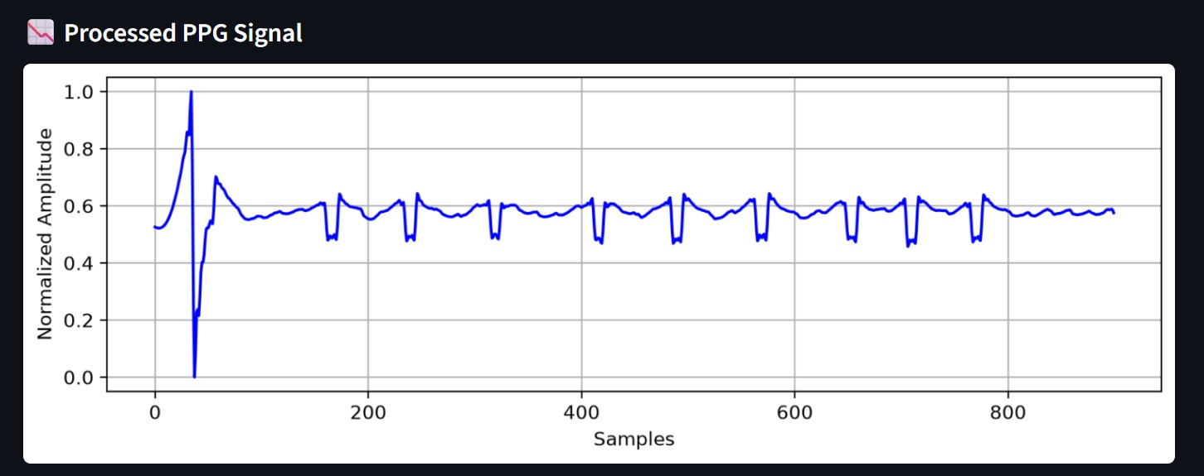
OUTPUTS:

Slide 13
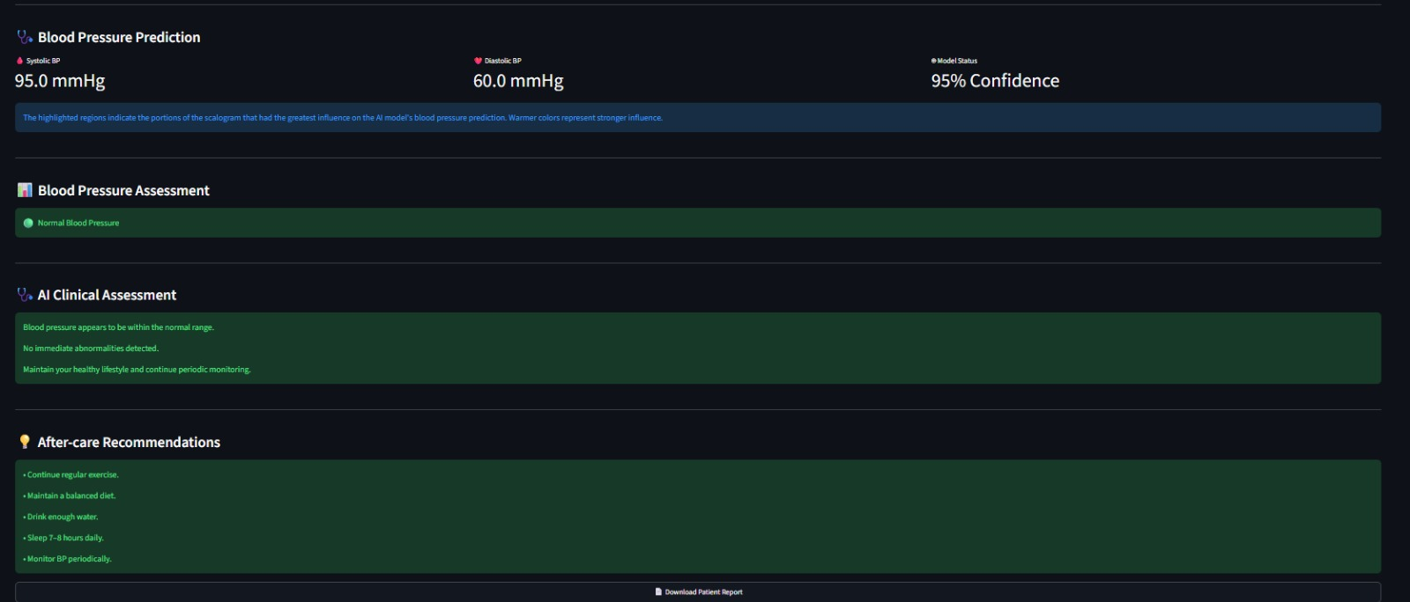

Slide 14
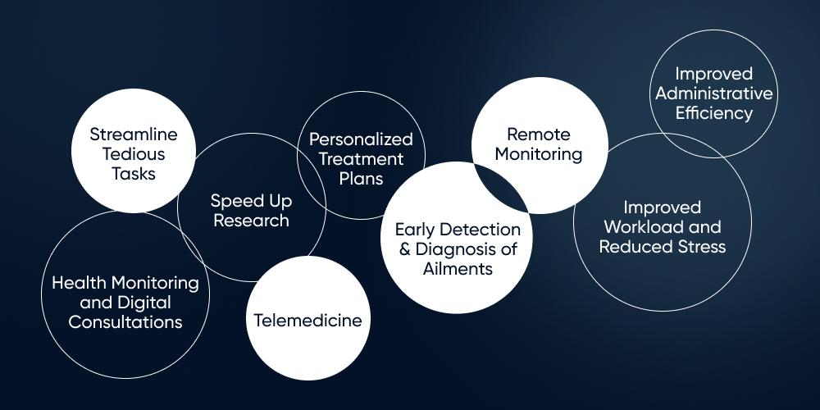
Advantages and applications:
The proposed system has wide-ranging applications in hospitals, home healthcare, telemedicine, wearable devices, and smart health monitoring systems. By enabling continuous, non-invasive blood pressure estimation, it supports early disease detection, remote patient monitoring, and personalized healthcare while reducing dependence on traditional cuff-based devices.
Applications:
🏥 Hospital & ICU Monitoring
🏠 Home Healthcare
👴 Elderly Care
📱 Telemedicine
⌚ Wearable Devices
❤️ Hypertension Management
🚑 Emergency Healthcare
🌍 Rural Healthcare
💪 Fitness & Wellness
🔬 Medical Research
📊 Personal Health Tracking
🤖 Smart Healthcare Systems

Slide 15
Conclusion & Future Scope
This project successfully demonstrates an AI-powered, cuffless blood pressure estimation system using Photoplethysmography (PPG) signals and a Vision Transformer (ViT). By transforming PPG signals into scalogram images through Continuous Wavelet Transform (CWT), the proposed system accurately predicts systolic and diastolic blood pressure without the need for a conventional cuff. The results highlight the potential of deep learning to provide a non-invasive, continuous, and patient-friendly solution for cardiovascular monitoring, paving the way for the next generation of intelligent healthcare systems.
Future Enhancements:
📷 Live Smartphone Camera Integration for real-time PPG signal acquisition.
⌚ Smartwatch & Wearable Device Support for continuous health monitoring.
🌐 Cloud-Based Patient Monitoring for remote healthcare and telemedicine.
🤖 Advanced AI Models to improve prediction accuracy and robustness.
🏥 Clinical Validation using larger and more diverse patient populations.
📱 Mobile Application Development for anytime, anywhere monitoring.
☁️ IoT Integration for smart hospitals and connected healthcare systems.
⚡ Edge AI Deployment for fast, offline, and energy-efficient prediction.
📊 Personal Health Dashboard for long-term BP trends and health analytics.
🌍 Affordable Healthcare Solution for rural and underserved communities.

